Slide 1
OFFSET SLIDER CRANK MECHANISM 19PHY113-COMPUTATIONAL ENGINEERING MECHANICS
DEEPTHI SUDHARSAN CB.EN.U4AIE19022
ISHA INDHU S CB.EN.U4AIE19030
JAYASHREE O CB.EN.U4AIE19031
KAVYA S KUMAR CB.EN.U4AIE19037
LAKSHAYA K CB.EN.U4AIE19039
meghna menon CB.EN.U4AIE19043

Slide 2
TABLE OF CONTENTS
01
02
03
INTRODUCTION
ANALYSIS
PYTHON CODE
04
05
SIMULATION
APPLICATIONS
Introduction to offset slider crank mechanism
Position, Velocity and Acceleration Analysis
Code to find the instantaneous position, velocity and acceleration of different links
A MATLAB simulation on how the mechanism works
Different applications of the offset slider crank mechanism

Slide 3
01
INTRODUCTION
INTRODUCTION TO GRASHOFS AND SLIDER CRANK MECHANISM

Slide 4
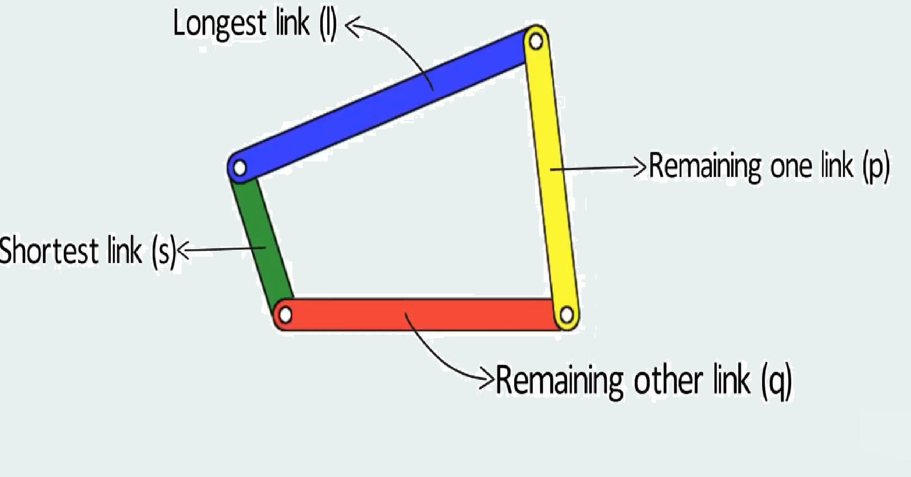
Grashof Criteria
Grashof Criteria :
The theorem states that for the linkage to contain at least one link which can fully revolve with respect to the other three links:
S + L < P + Q
Where S – smallest link
L – longest link
P , Q – other two links

Slide 5
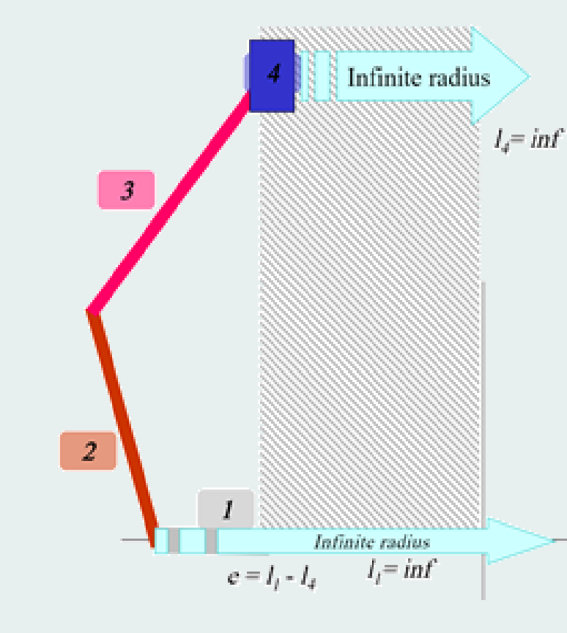
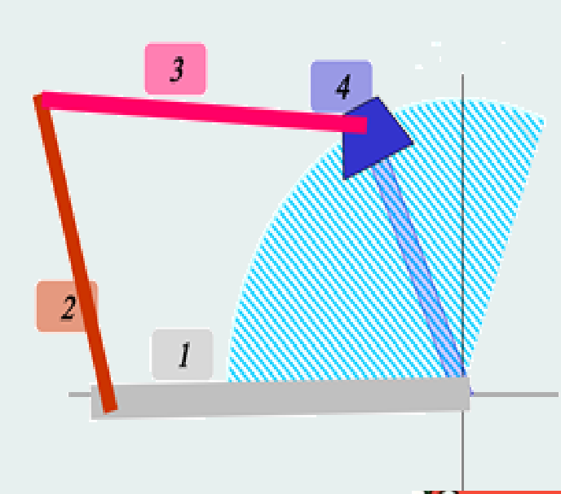

Slider Crank Mechanism
Incase of a slider crank mechanism the radius of rotation for a slider will be infinity like shown in the second figure.
Grashof condition becomes:
L2 + L1 < L3 + L4
L2+ ( L1 – L4 ) < L3
L2 + e < L3
Where e – offset
L2 – Length of crank (also the smallest)
L3 – Length of coupler
$$∴$$

Slide 6
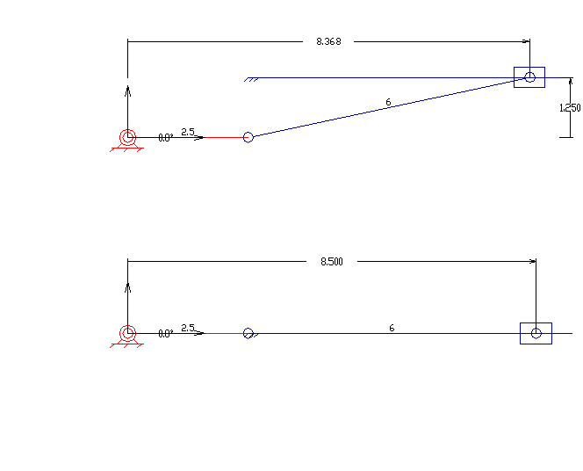
Slider Crank Mechanism
A slider-crank linkage - 4 link mechanism:
3 revolute joints ,1 sliding joint.
A rotatory motion is converted into a linear motion of a slider.
There are two types of slider-cranks: in-line and offset:
Inline – the slider is placed along the line joining the hinge point of crank creating symmetric slider movement back and forth as the crank rotates.
Offset - line of travel of the hinged joint of the slider does not pass through the base pivot of the crank, the slider movement is not symmetric. It moves faster in one direction than the other.
Offset
Inline

Slide 7
QUICK RETURN MECHANISM
The main difference between between the inline slider crank mechanism and offset slider crank mechanism is that :
There is an offset given between the two centers (i.e the axis of the crank and the slider).
The advantage is that the rotary motion can be converted to rectilinear motion and either the forward or backward motion of the mechanism is quicker than the other.

Slide 8
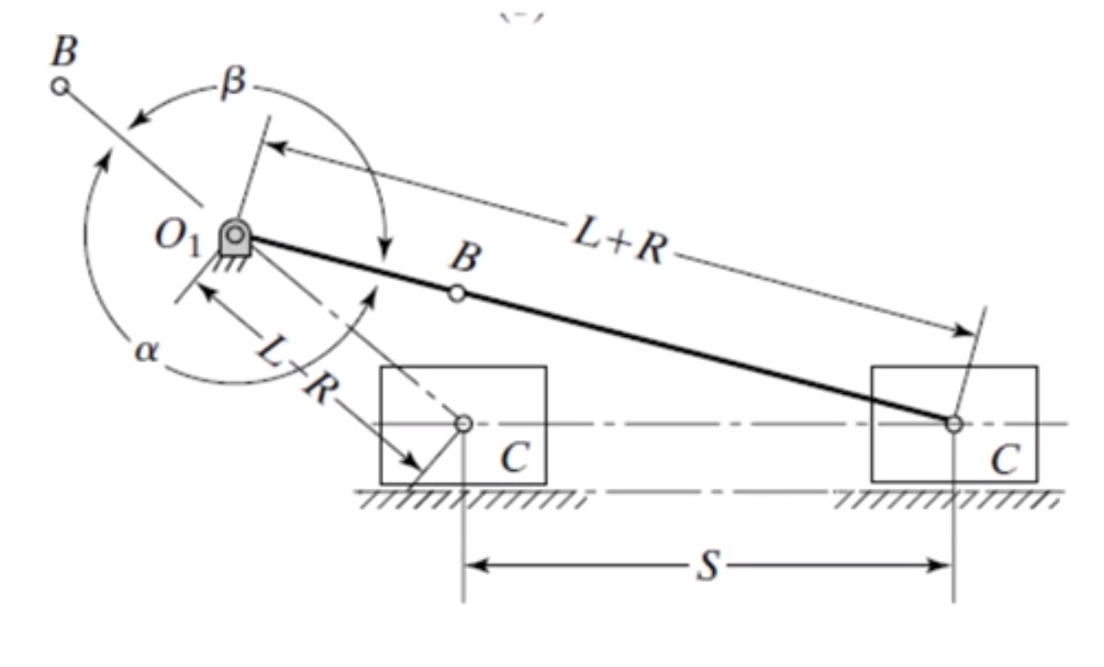
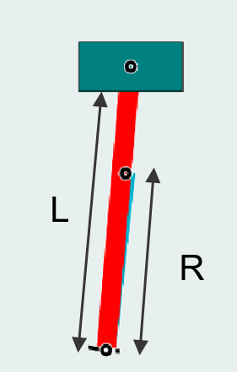
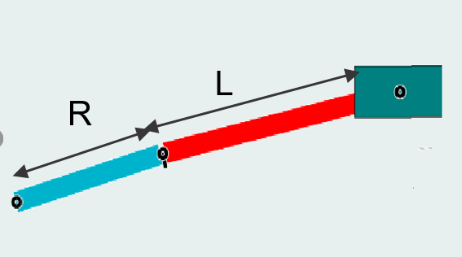
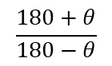
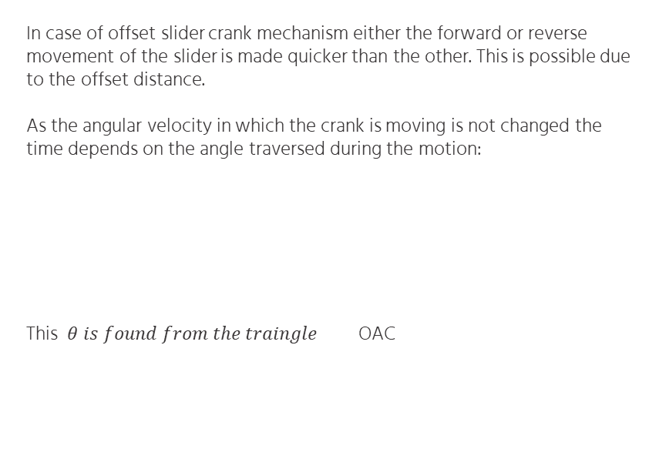
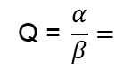
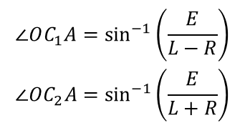
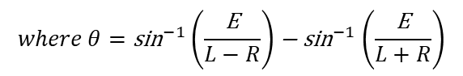
Advantage of Offset
In case of offset slider crank mechanism either the forward or reverse movement of the slider is made quicker than the other. This is possible due to the offset distance.
As the angular velocity in which the crank is moving is not changed the time depends on the angle traversed during the motion:
This $θ is found from the traingle$ OAC
E
A
$$\text{Q}\text{ = }\frac{α}{β}=$$
$$\frac{180+θ}{180−θ}$$
$$where θ={\text{sin}}^{−1}\left(\frac{\text{E}}{L−R}\right){\text{− }\text{sin}}^{−1}\left(\frac{\text{E}}{L+R}\right)$$
$$\begin{matrix}∠OC_{1}A=\sin^{−1}\left(\frac{E}{L−R}\right) \\ ∠OC_{2}A=\sin^{−1}\left(\frac{E}{L+R}\right)\end{matrix}$$
Extreme left and right position of slider

Slide 9
02
ANALYSIS
Position, Velocity and Acceleration Analysis

Slide 10
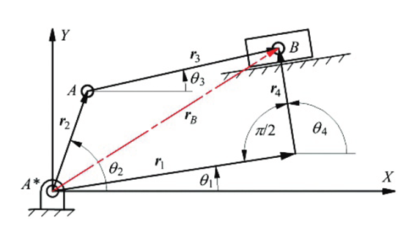
POSITION ANALYSIS
$$\begin{matrix}{\vec{r}}_{B}={\vec{r}}_{1}+{\vec{r}}_{4}={\vec{r}}_{2}+{\vec{r}}_{3} \\ \left.r_{1}(cosθ_{1}i+sinθ_{1}j)+r_{4}(cosθ_{4}i+sinθ_{4}j)=r_{2}(cosθ_{2}i+sinθ_{2}j)+r_{3}(cosθ_{3}i+sinθ_{3}j\right)\end{matrix}$$
Equating the components of
I and j

Slide 11
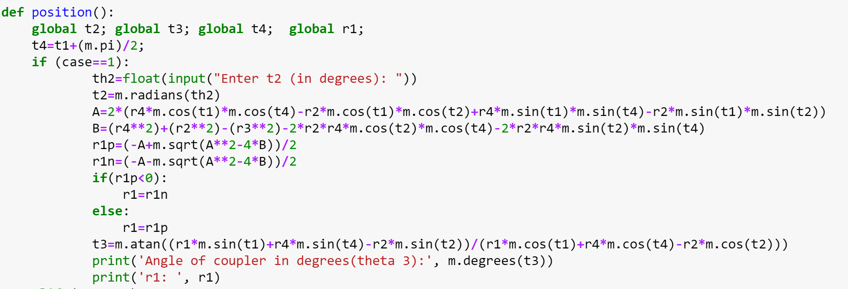
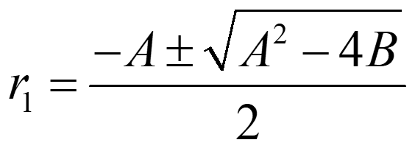
Case 1 : $θ_{2}$ given
Squaring the above two equation we get
Converting to quadratic form:

Slide 12
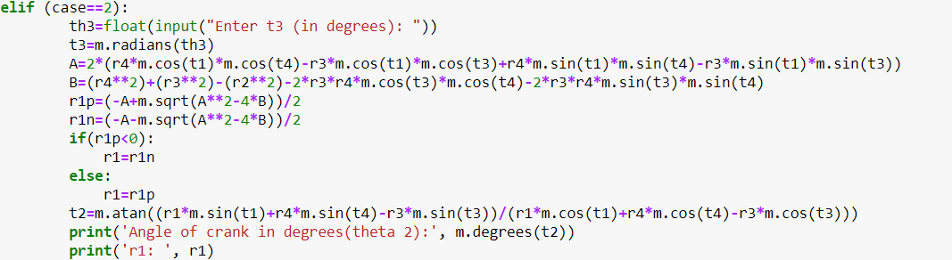
Case 2 : $θ_{3}$ given
Squaring the above two equations, and converting them to quadratic, we get
In this case A and B are

Slide 13
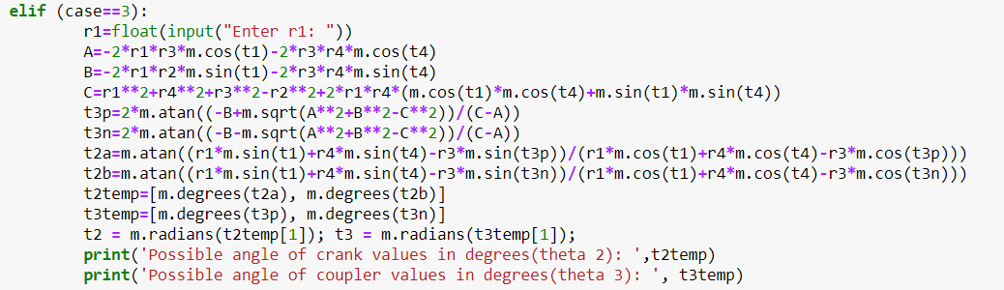
Case 3 : $r_{1}$ given
Squaring the above two equation and representing it in the form

Slide 14
$$\begin{matrix}Let t=tan\left(\frac{θ_{2}}{2}\right) sinθ_{2}=\frac{2t}{1+t^{2}} cosθ_{2}=\frac{1−t^{2}}{1+t^{2}} \\ (C−A)t^{2}+2Bt+(A+C)=0 \\ tan\left(\frac{θ_{2}}{2}\right)=\frac{−B±\sqrt{A^{2}+B^{2}−C^{2}}}{\left(C−A\right)} \\ θ_{2}=2\tan^{−1}\left(\frac{−B±\sqrt{A^{2}+B^{2}−C^{2}}}{\left(C−A\right)}\right) \\ θ_{3}=\tan^{−1}\left(\frac{r_{1}sinθ_{1}+r_{4}sinθ_{4}−r_{3}sinθ_{3}}{r_{1}cosθ_{1}+r_{4}cosθ_{4}−r_{3}cosθ_{3}}\right)\end{matrix}$$

Slide 15
VELOCITY ANALYSIS
Differentiating the equation obtained from position analysis we get,
$$\dot{{−r}_{1}}\left(cosθ_{1 }i+sinθ_{1}j\right)+r_{2 }{\dot{θ}}_{2}\left(−sinθ_{2 }i+cosθ_{2 }j\right)+r_{3}{\dot{θ}}_{3}\left(−sinθ_{3}i+cosθ_{3}j\right)=0$$
Considering case 1, $when {\dot{,θ}}_{2} and {\dot{θ}}_{3}$are unknown,
$$\left[\begin{matrix}−r_{2}sinθ_{2} & −r_{3}sinθ_{3} \\ r_{2}cosθ_{2} & r_{3}cosθ_{3}\end{matrix}\right] \left[\begin{matrix}{\dot{θ}}_{2} \\ {\dot{θ}}_{3}\end{matrix}\right]=\left[\begin{matrix}\dot{r_{1}}cosθ_{1 } \\ \dot{r_{1}}sinθ_{1}\end{matrix}\right]$$
Considering case 2, ${when ,\dot{θ}}_{2} and \dot{r_{1}}$ are unknown
$$\left[\begin{matrix}cosθ_{1} & r_{2}sinθ_{2 } \\ sinθ_{1} & {−r}_{2}cosθ_{2}\end{matrix}\right] \left[\begin{matrix}\dot{r1} \\ {\dot{θ}}_{2}\end{matrix}\right]=\left[\begin{matrix}−r_{3}{\dot{θ}}_{3}sinθ_{3} \\ r_{3}{\dot{θ}}_{3}cosθ_{3}\end{matrix}\right]$$
Considering case 3, $when, {\dot{θ}}_{3} and \dot{r_{1}}$ are unknown
$$\left[\begin{matrix}cosθ_{1} & r_{3}sinθ_{3 } \\ sinθ_{1} & {−r}_{3}cosθ_{3}\end{matrix}\right] \left[\begin{matrix}\dot{r1} \\ {\dot{θ}}_{3}\end{matrix}\right]=\left[\begin{matrix}−r_{2}{\dot{θ}}_{2}sinθ_{2} \\ r_{2}{\dot{θ}}_{2}cosθ_{2}\end{matrix}\right]$$

Slide 16
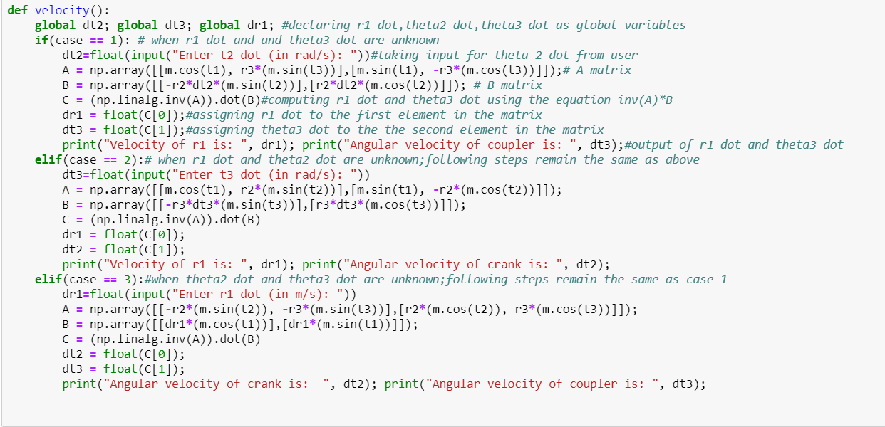
Python Code -Velocity Analysis

Slide 17
ACCELERATION ANALYSIS
Differentiating the equation obtained from velocity analysis we get,
Considering case 1,
Considering case 2,
Considering case 3,

Slide 18
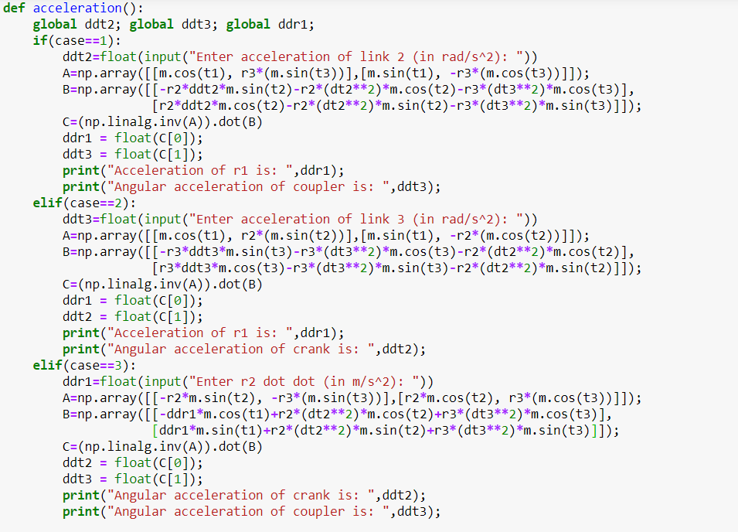
Python Code -Acceleration Analysis

Slide 19
04
SIMULATION
MATLAB code for simulation of slider crank

Slide 20
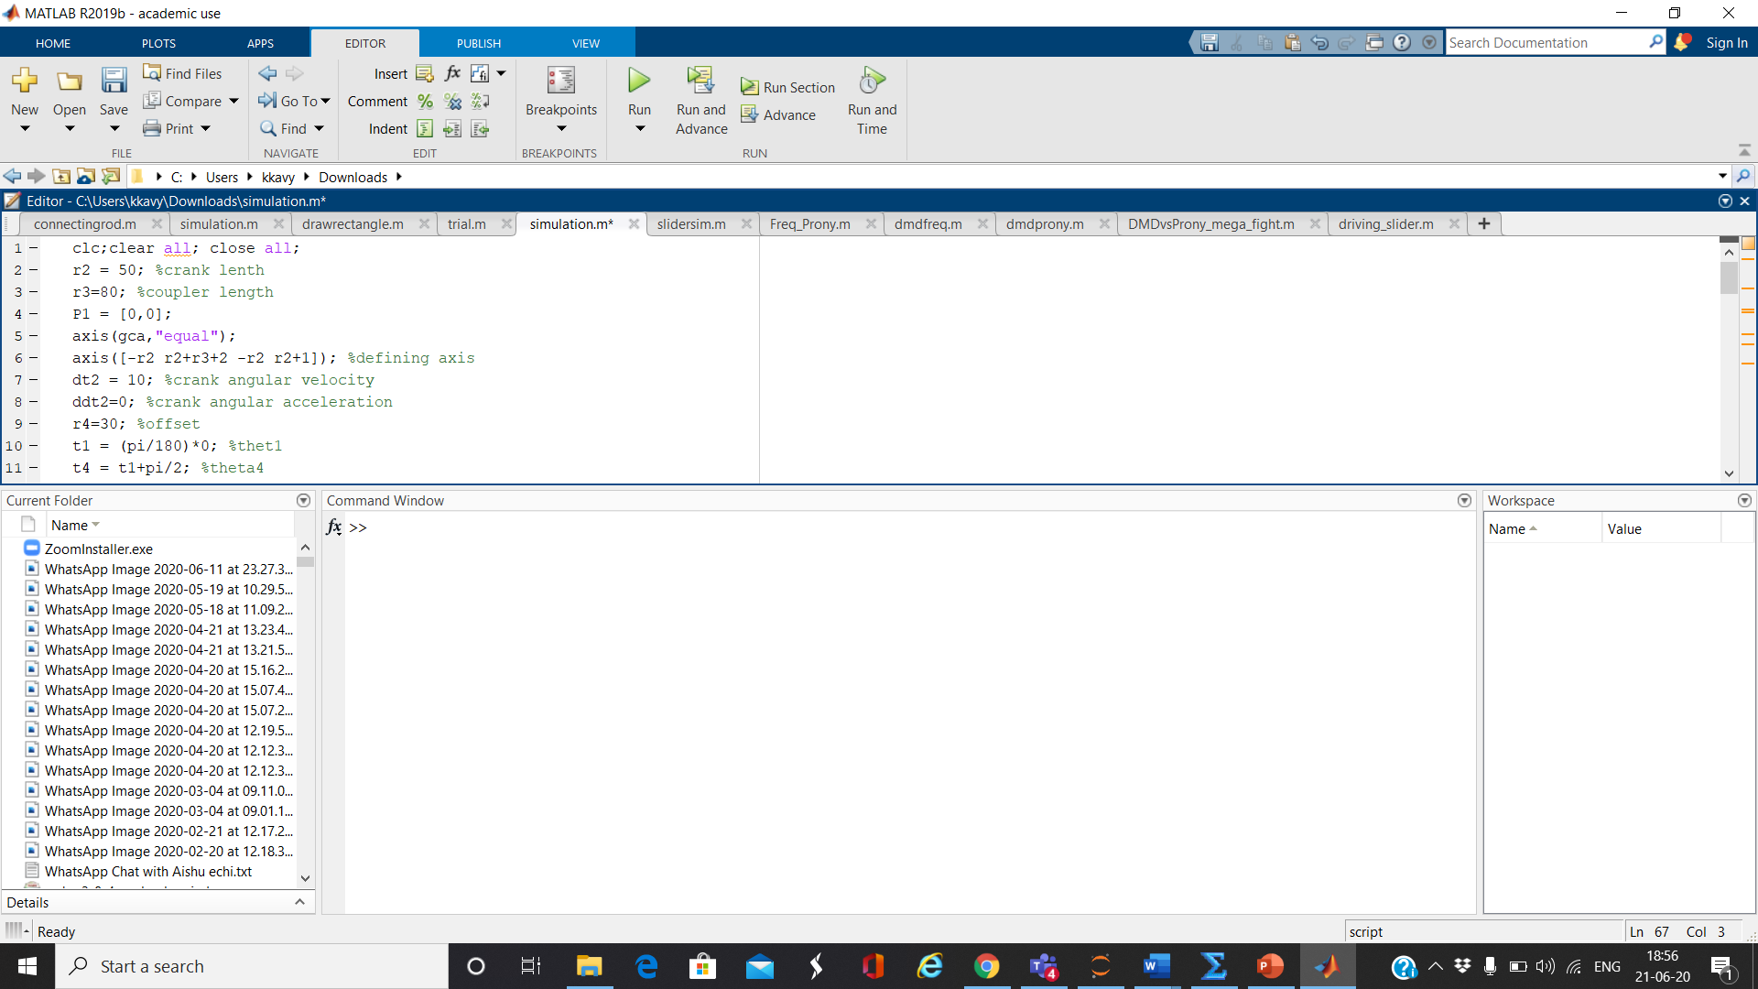
SIMULATION
Initialising the following:
Coupler Length
Crank Length
Offset
theta 1
Angular velocity of crank
Angular acceleration of crank
Defining axis for the plot

Slide 21
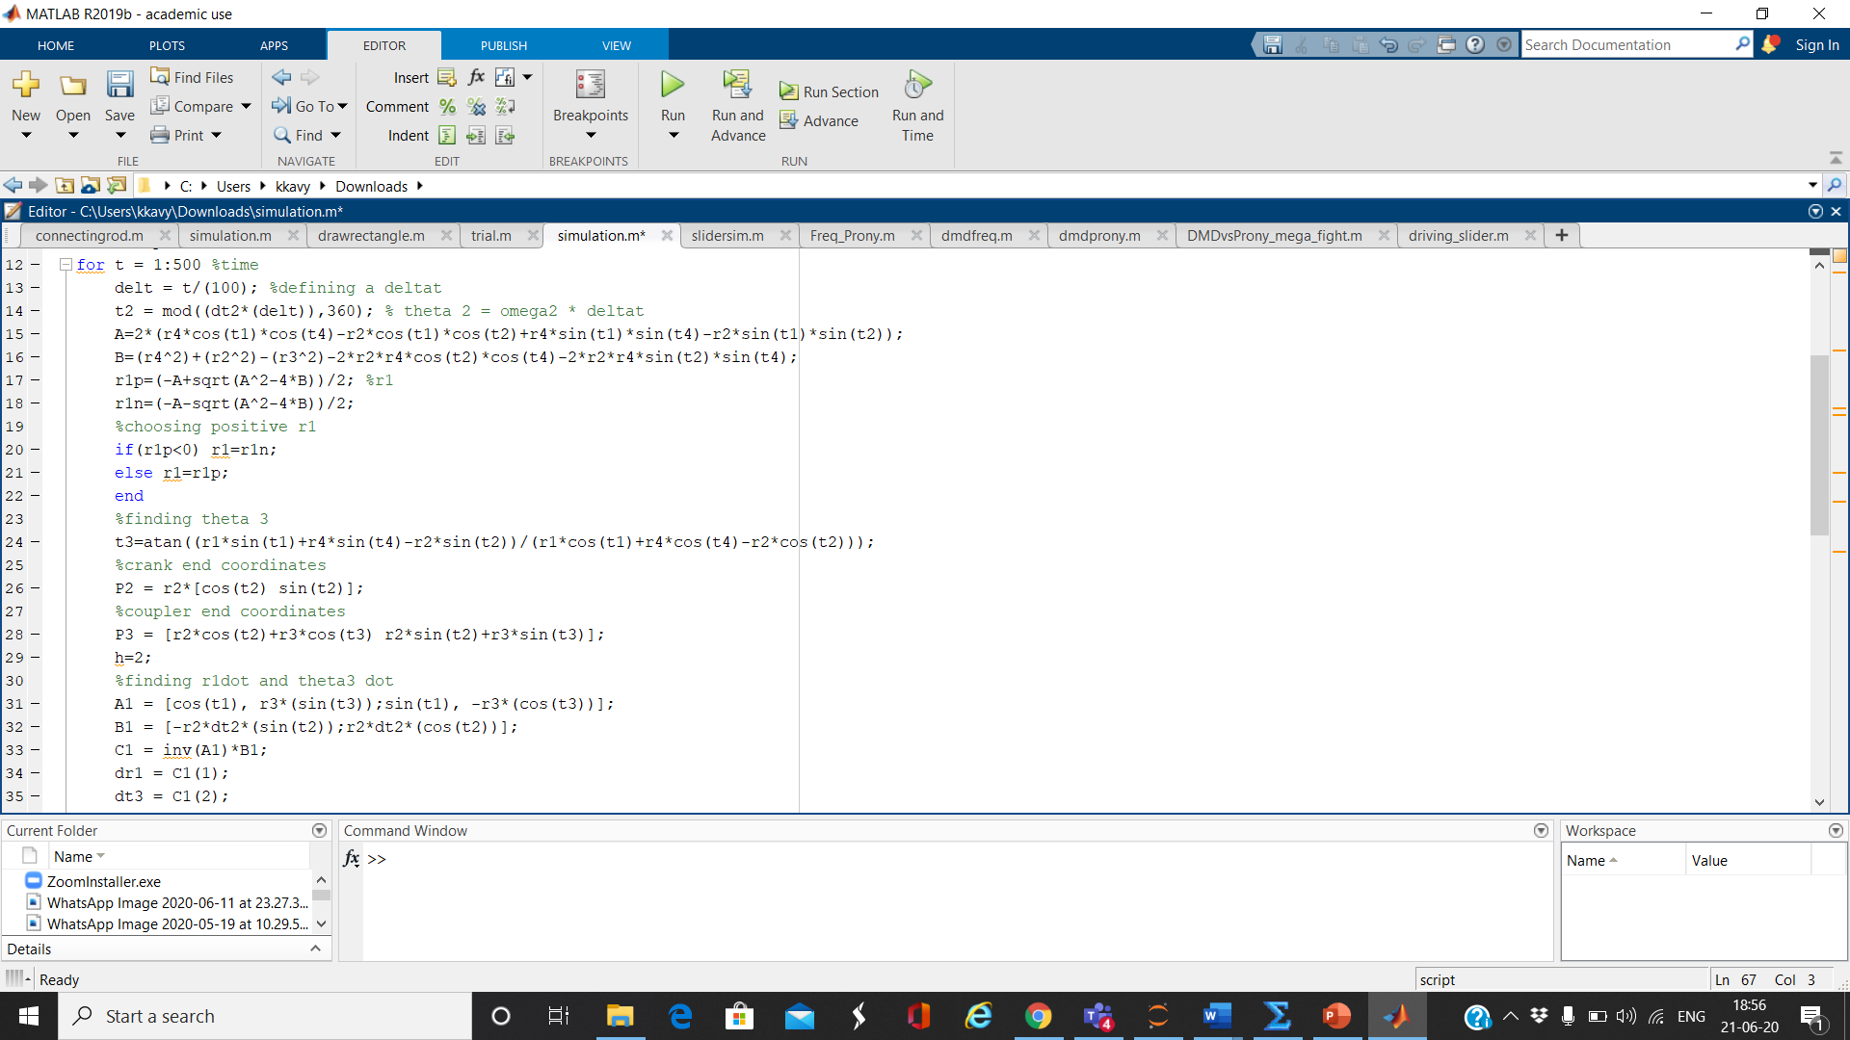
Iterating through a for loop with t as the time variable
Theta2 = angular velocity of crank * deltat
Finding A & B using equations derived in position analysis
r1 is the positive root obtained from the solution of the quadratic equation formed
Theta3 is then obtained using theta2
Then the end coordinates of crank and coupler are found.

Slide 22
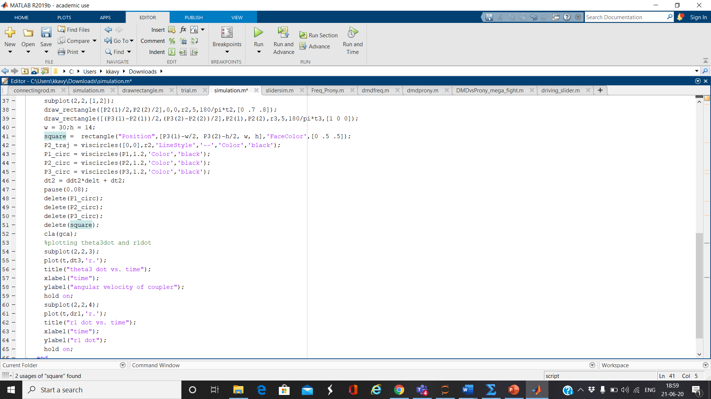
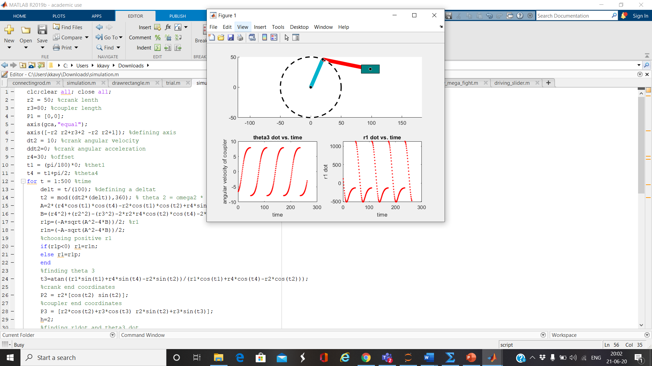
OUTPUT PLOT

Slide 23
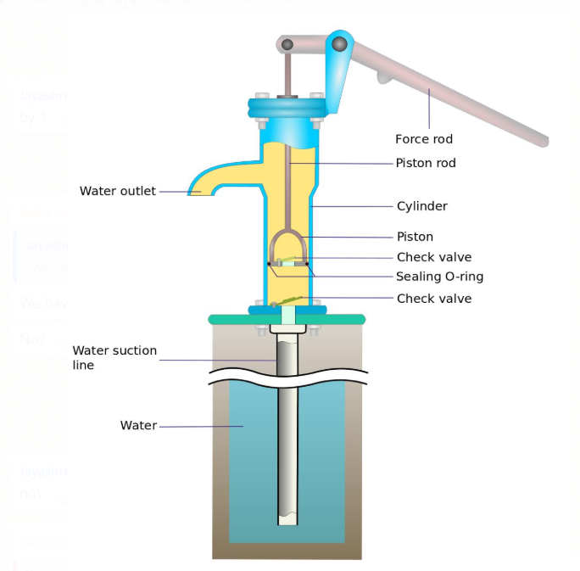
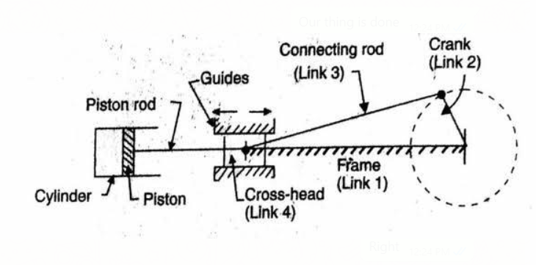
APPLICATIONS OF SLIDER CRANK MECHANISM
Hand Pump
This is one of the most common applications of this mechanism.The principle of hand pump is creating low pressure to suck the underground water.

Slide 24
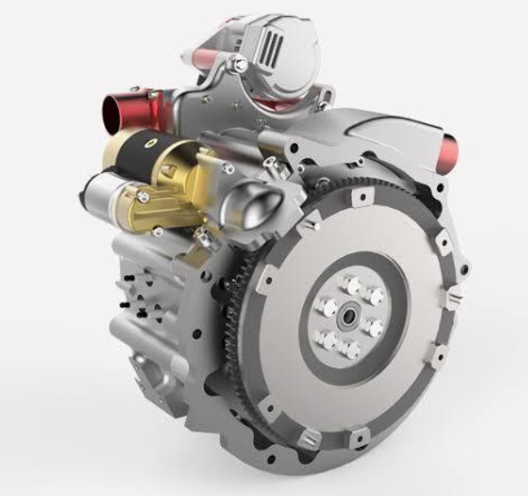
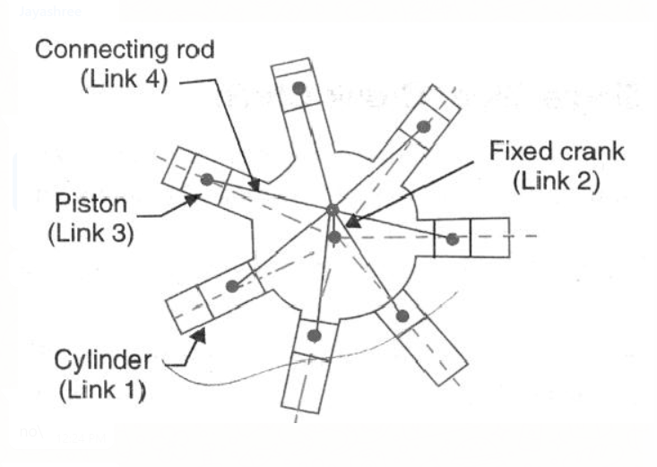
Rotary Engines
They are a type of internal combustion engine, used in cars, which converts heat from the combustion of a high pressure air/fuel mixture into useful work for the rest of the car.

Slide 25
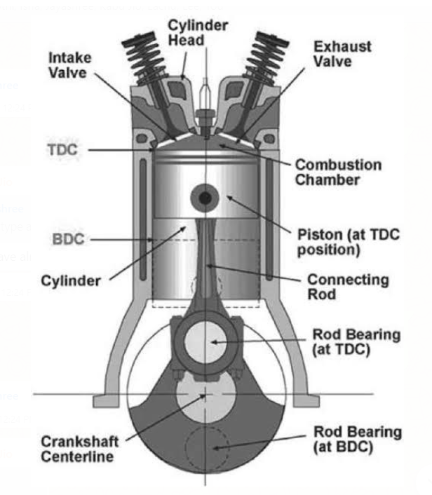
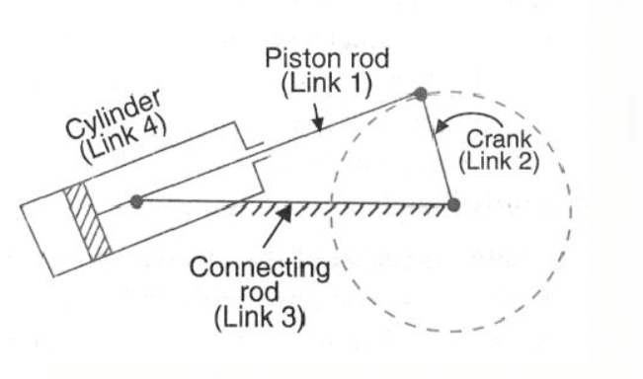
Reciprocating Engine
A reciprocating engine is an engine that uses one or more pistons in order to convert pressure into rotational motion..

Slide 26
THANK YOU

